Slide 1
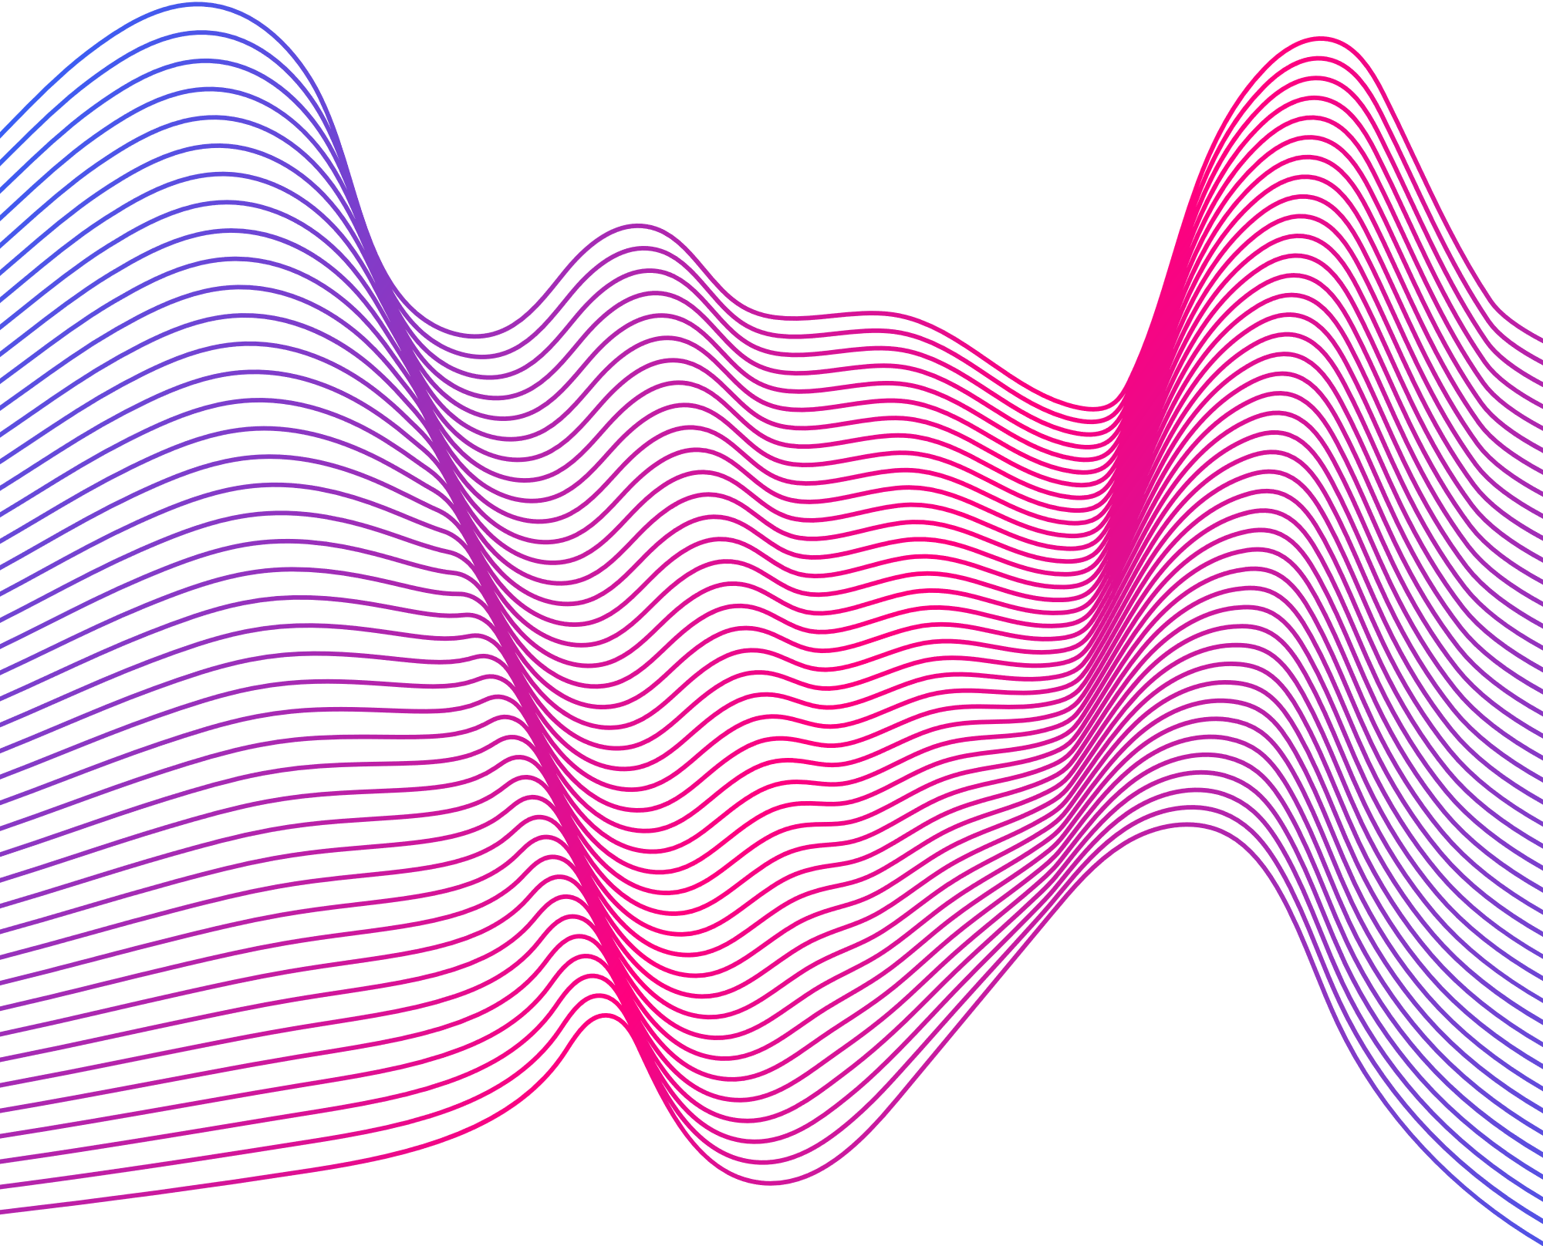


Sign Language Recognition
Sign Speaks
Supervizied by
Dr. Khaled Fathy
Eng. Mina Nagy
SignSpeaks
Add Company Name

Slide 2
Team
Name
ID
Marwa Hany Fouad
Kirolos Magdy Agaiby
Ahmed Sobhi Fouad
Omar Mohamed Abdelaziz
Martrem Yasser Morris
Nirvana Demian Badie
Salma Ayman Fawzy
20-01626
20-00010
19-01371
19-00756
20-01287
20-01030
20-00499
Sign Speaks
SignSpeaks
Add Company Name

Slide 3

1.
Introduction
SignSpeaks

Slide 4
Introduction
This project focused on developing a website that utilizes Artificial Intelligence (AI) and Machine Learning (ML) to address the real-world problem of the shortage of sign language interpreters.
Sign Speaks
SignSpeaks
Add Company Name

Slide 5
2.
Problem Statement
SignSpeaks

Slide 6
Problem Statement
Communication Barriers:
Sign language users often face social isolation and difficulty in everyday communication.
Service Accessibility:
Challenges in accessing essential services such as healthcare, education, and employment due to a lack of sign language interpreters.
Sign Speaks
SignSpeaks
Add Company Name

Slide 7
Proposed Solution
AI and ML-based Website:
Sign Speaks
Real-time Translation:
The website captures Arabic sign language gestures using a camera and translates them into written Arabic text instantly.
Technological Integration:
Combines deep learning and computer vision technologies to recognize and interpret hand gestures.
SignSpeaks
Add Company Name

Slide 8
3.
Objectives
SignSpeaks

Slide 9
Objectives
Accessibility and Inclusivity
Education and Awareness
Real-Time Sign Language Recognition
Creating a website enables the hearing-impaired and deaf to communicate with people who do not speak sign language.
Let people know that there is a difference between different sign languages ​​and raise awareness about the challenges faced by the deaf
Implement sign language in real time through AI and Machine learning to make communication fast and smooth
SignSpeaks
Add Company Name

Slide 10
4.
Dataset
SignSpeaks

Slide 11
Introduction
Sign Speaks
It is a collection of videos created specifically for training and evaluating models for American Sign Language (ASL) recognition at the word level.
SignSpeaks
Add Company Name

Slide 12
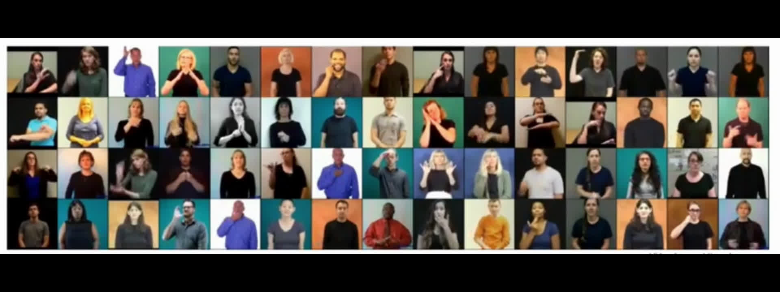
Dataset Collection
Contains more than 2,000 words.
Includes over 21,000 videos performed by 119 signers.
SignSpeaks
Add Company Name

Slide 13
Features
Video Samples
It contains videos of people performing individual ASL signs corresponding to different words.
Annotations
Provides gloss labels, temporal boundries, body bounding boxes.
Training and Evaluation
The dataset is divided into subsets for training and testing machine learning models.
SignSpeaks
Add Company Name

Slide 14
Purpose
Sign Speaks
Aims to facilitate the development of practical sign language recognition models by providing a substantial amount of training data.
Enables the evaluation and comparison of various deep learning methods for word-level sign recognition
SignSpeaks
Add Company Name

Slide 15
Diversity
The dataset includes videos with varied backgrounds, illumination conditions, and signer appearances.
Designed to improve the generalization ability of sign recognition models in real-world scenarios.
SignSpeaks
Add Company Name

Slide 16
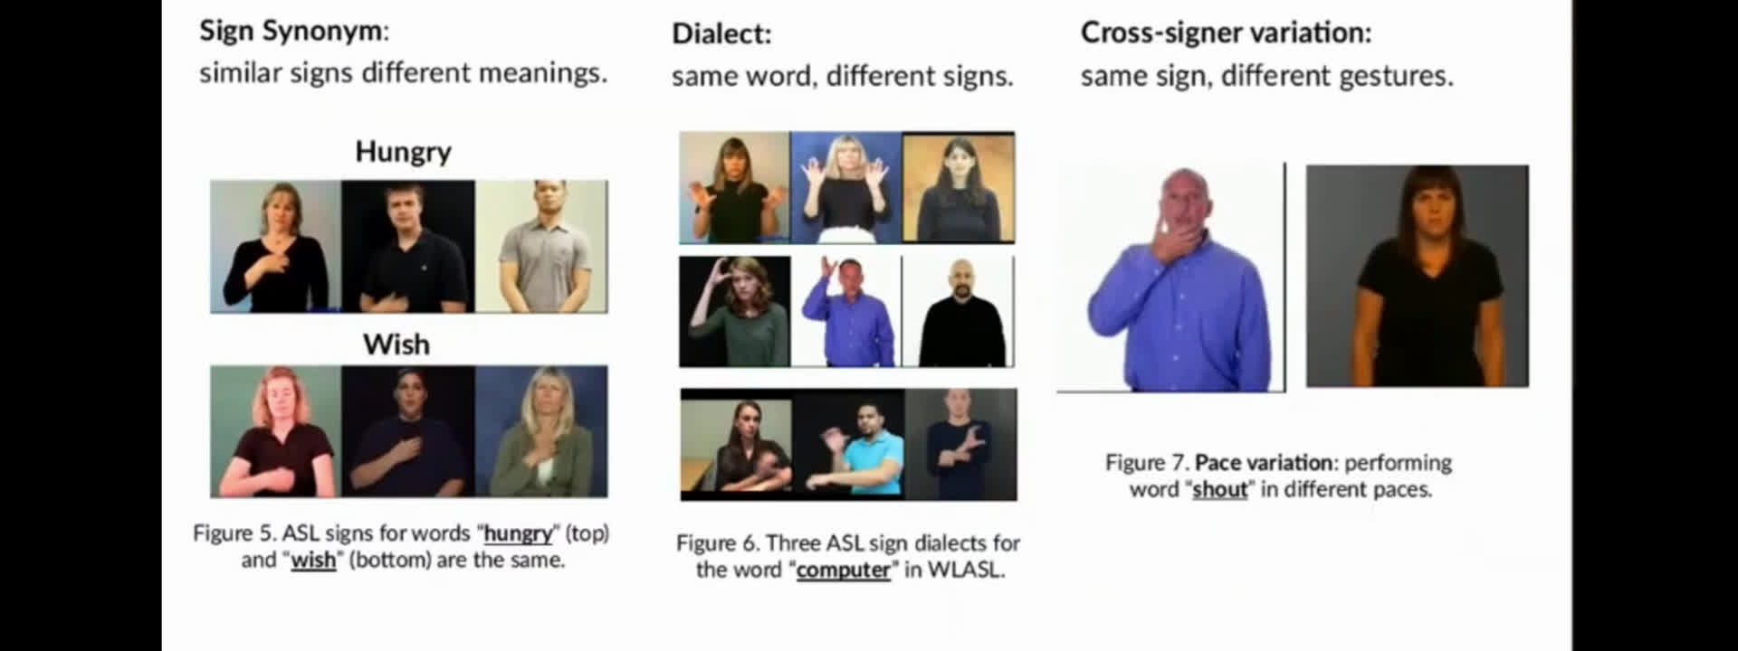
Diversity
SignSpeaks
Add Company Name

Slide 17
Benchmarking
Sign Speaks
Includes baseline models for benchmarking, such as holistic visual appearance-based approaches and 2D human pose-based approaches.
SignSpeaks
Add Company Name

Slide 18
5.
Model

Slide 19
Algorithm
Inceptional I3D
Is designed specifically for action recognition tasks.
Can handle sign language recognition projects and hand gesture control systems.
Captures both spatial and temporal features crucial for understanding actions and movements in video frames.
Sign Speaks
SignSpeaks
Add Company Name

Slide 20
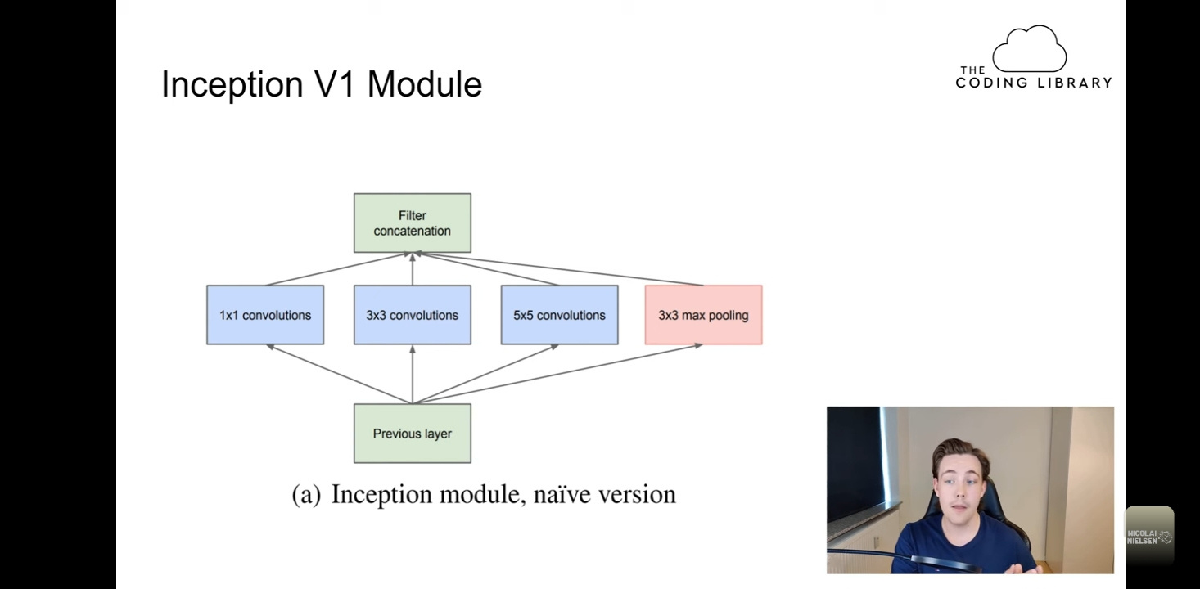
Go Wider, Not Deeper
SignSpeaks
Add Company Name

Slide 21
Go Wider, Not Deeper
Inceptional I3D V1
It chooses the operation or transformation on the layer to be sent to the next layer
There is problem with this version especially in naive form.
Sign Speaks
SignSpeaks
Add Company Name

Slide 22
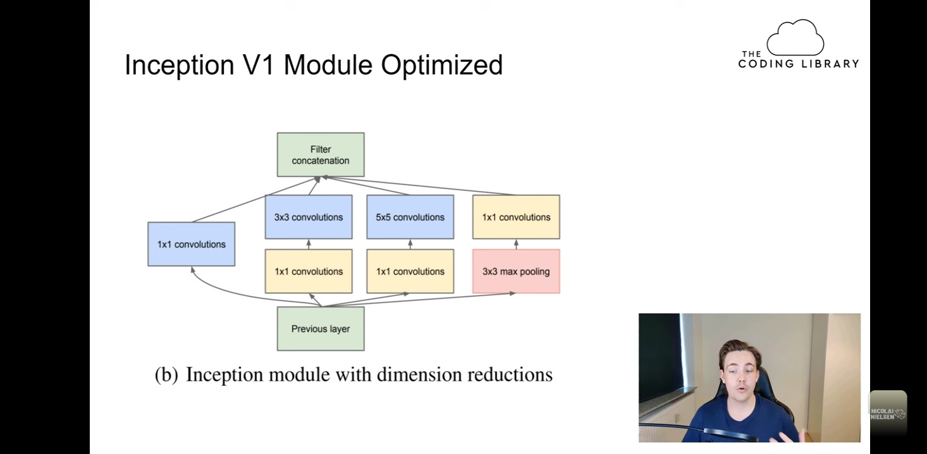
Go Wider, Not Deeper
SignSpeaks
Add Company Name

Slide 23
Go Wider, Not Deeper
Inceptional I3D V2
Solved the past version problem by choosing the best operation in a specific layer then concatenate them and select the best output to reduce the cost.
reducing dimensions on neural networks which is important for reducing complexity and computational cost
Sign Speaks
SignSpeaks
Add Company Name

Slide 24
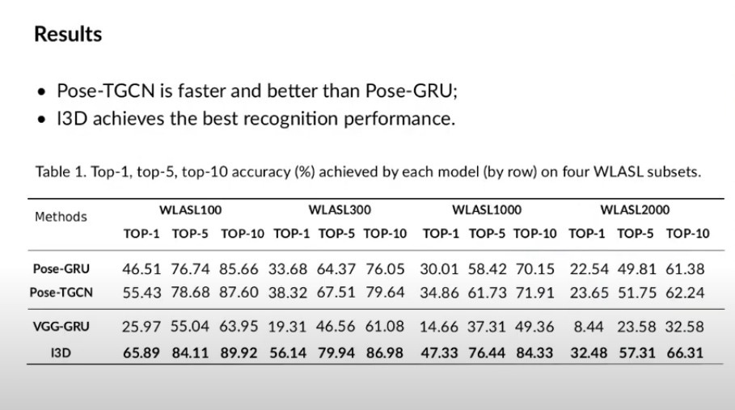
Accuracy
SignSpeaks
Add Company Name

Slide 25
Accuracy
SignSpeaks
Add Company Name

Slide 26
6.
Demo
SignSpeaks

Slide 27
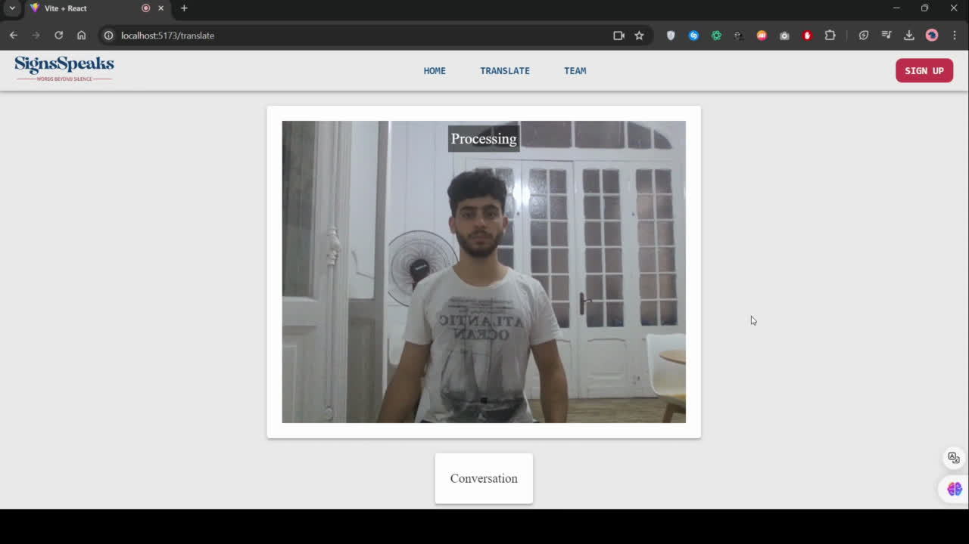
SignSpeaks

Slide 28
7.
Backend
SignSpeaks

Slide 29
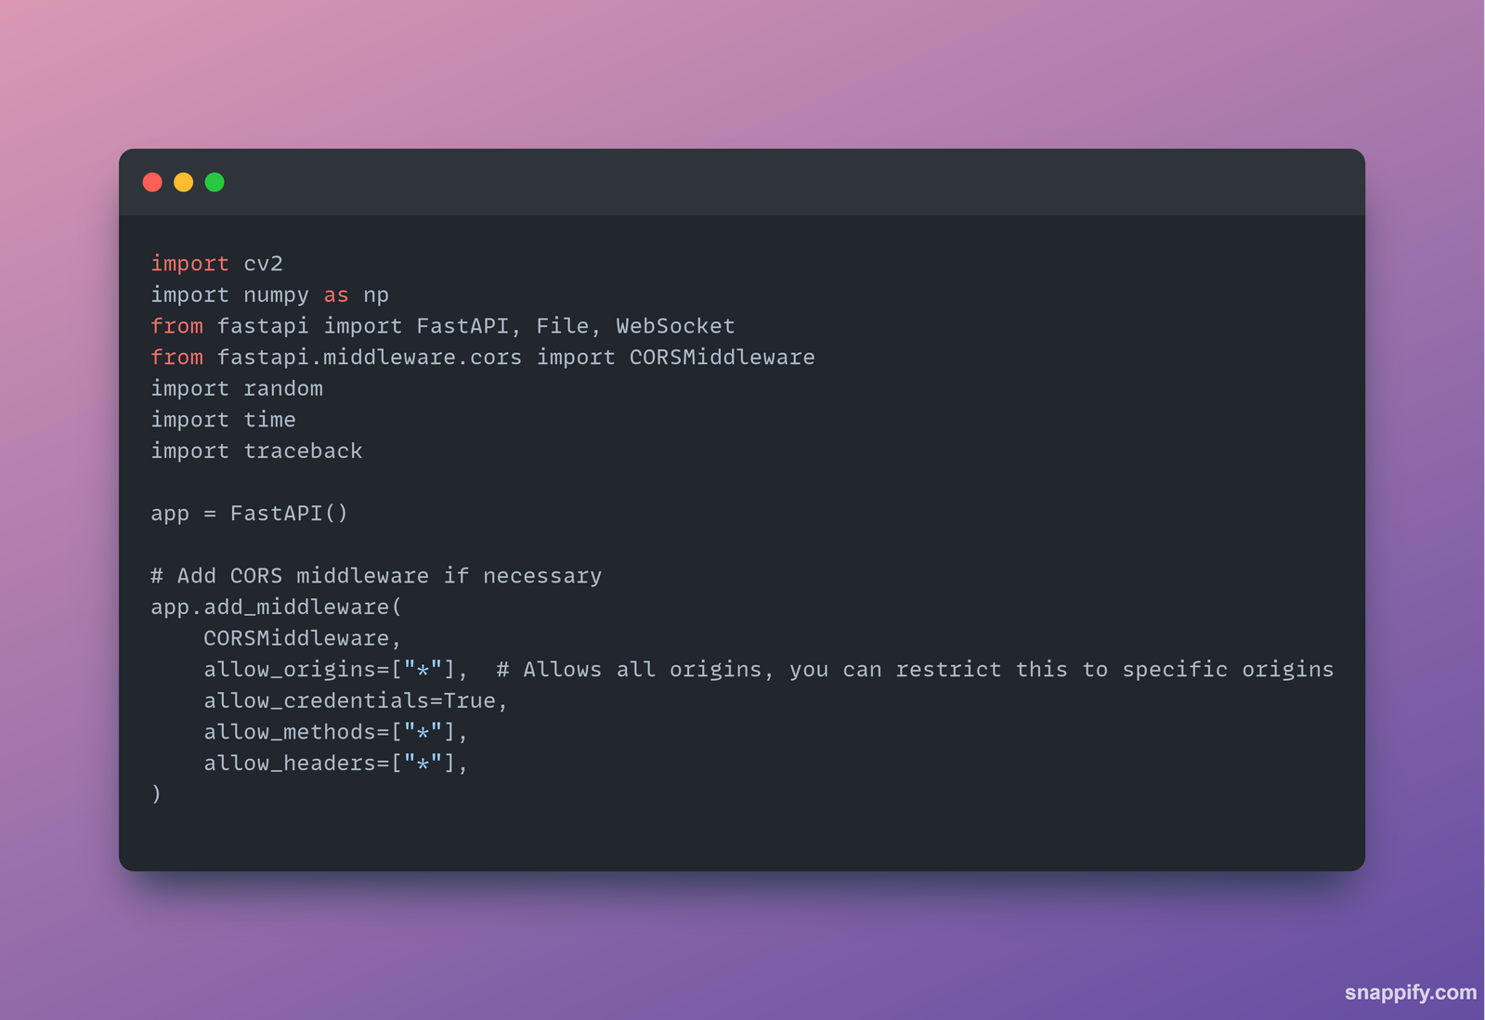
Imports
SignSpeaks
Add Company Name

Slide 30
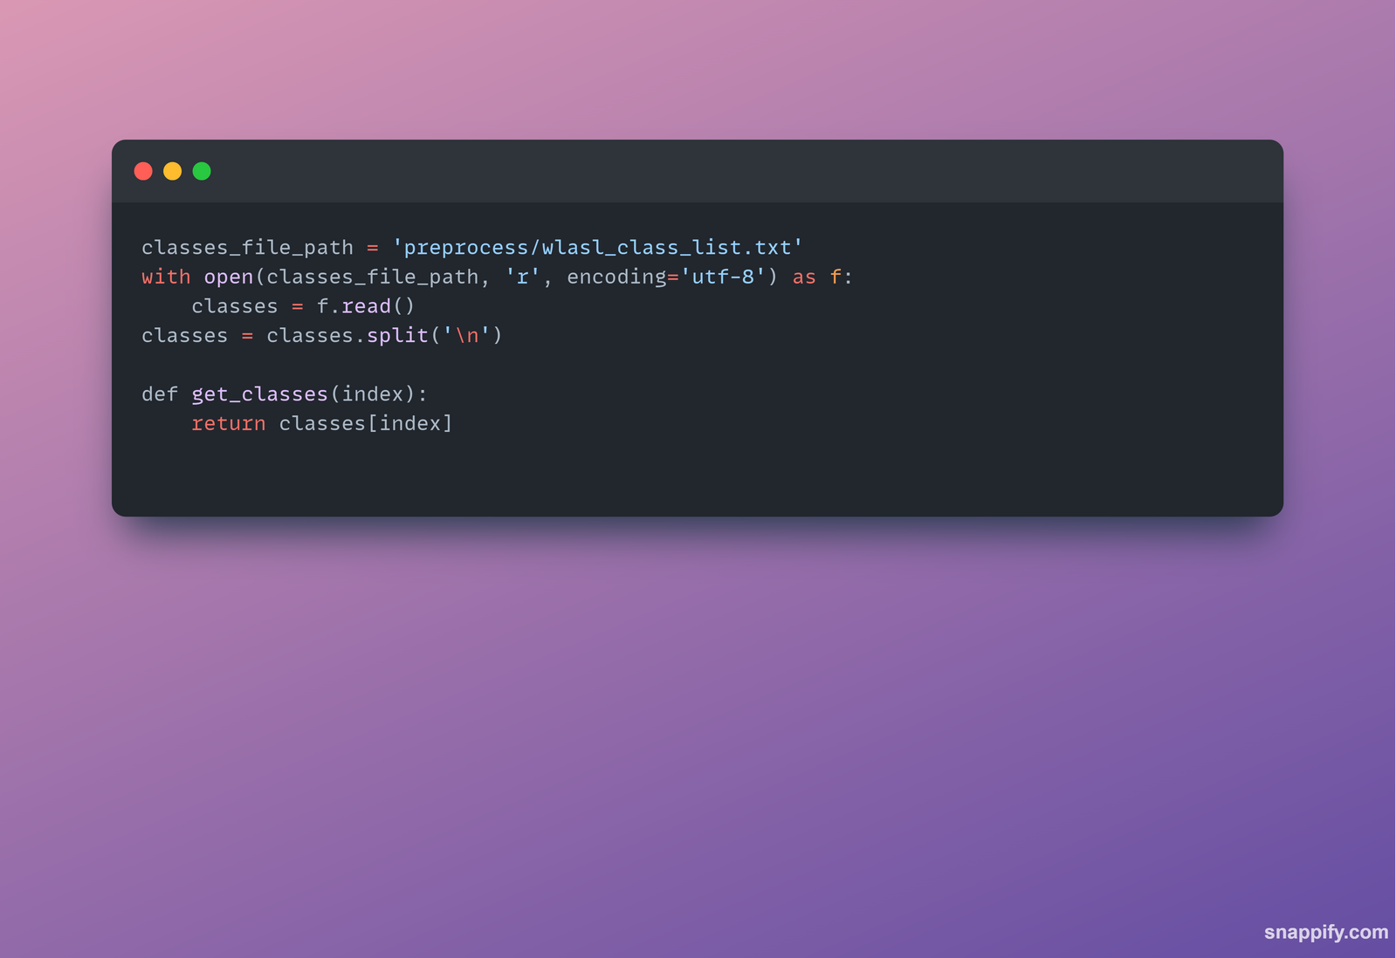
Classes
SignSpeaks
Add Company Name

Slide 31
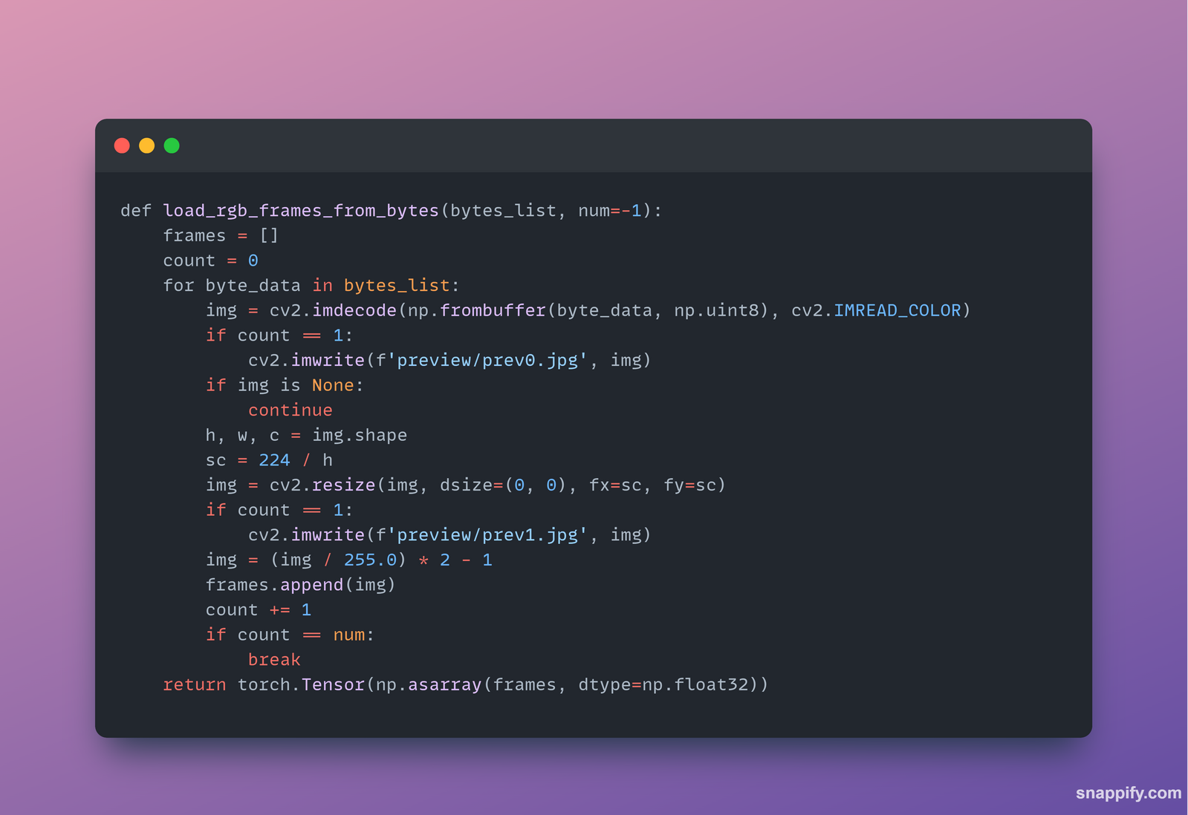
Frame Loading Function
SignSpeaks
Add Company Name

Slide 32
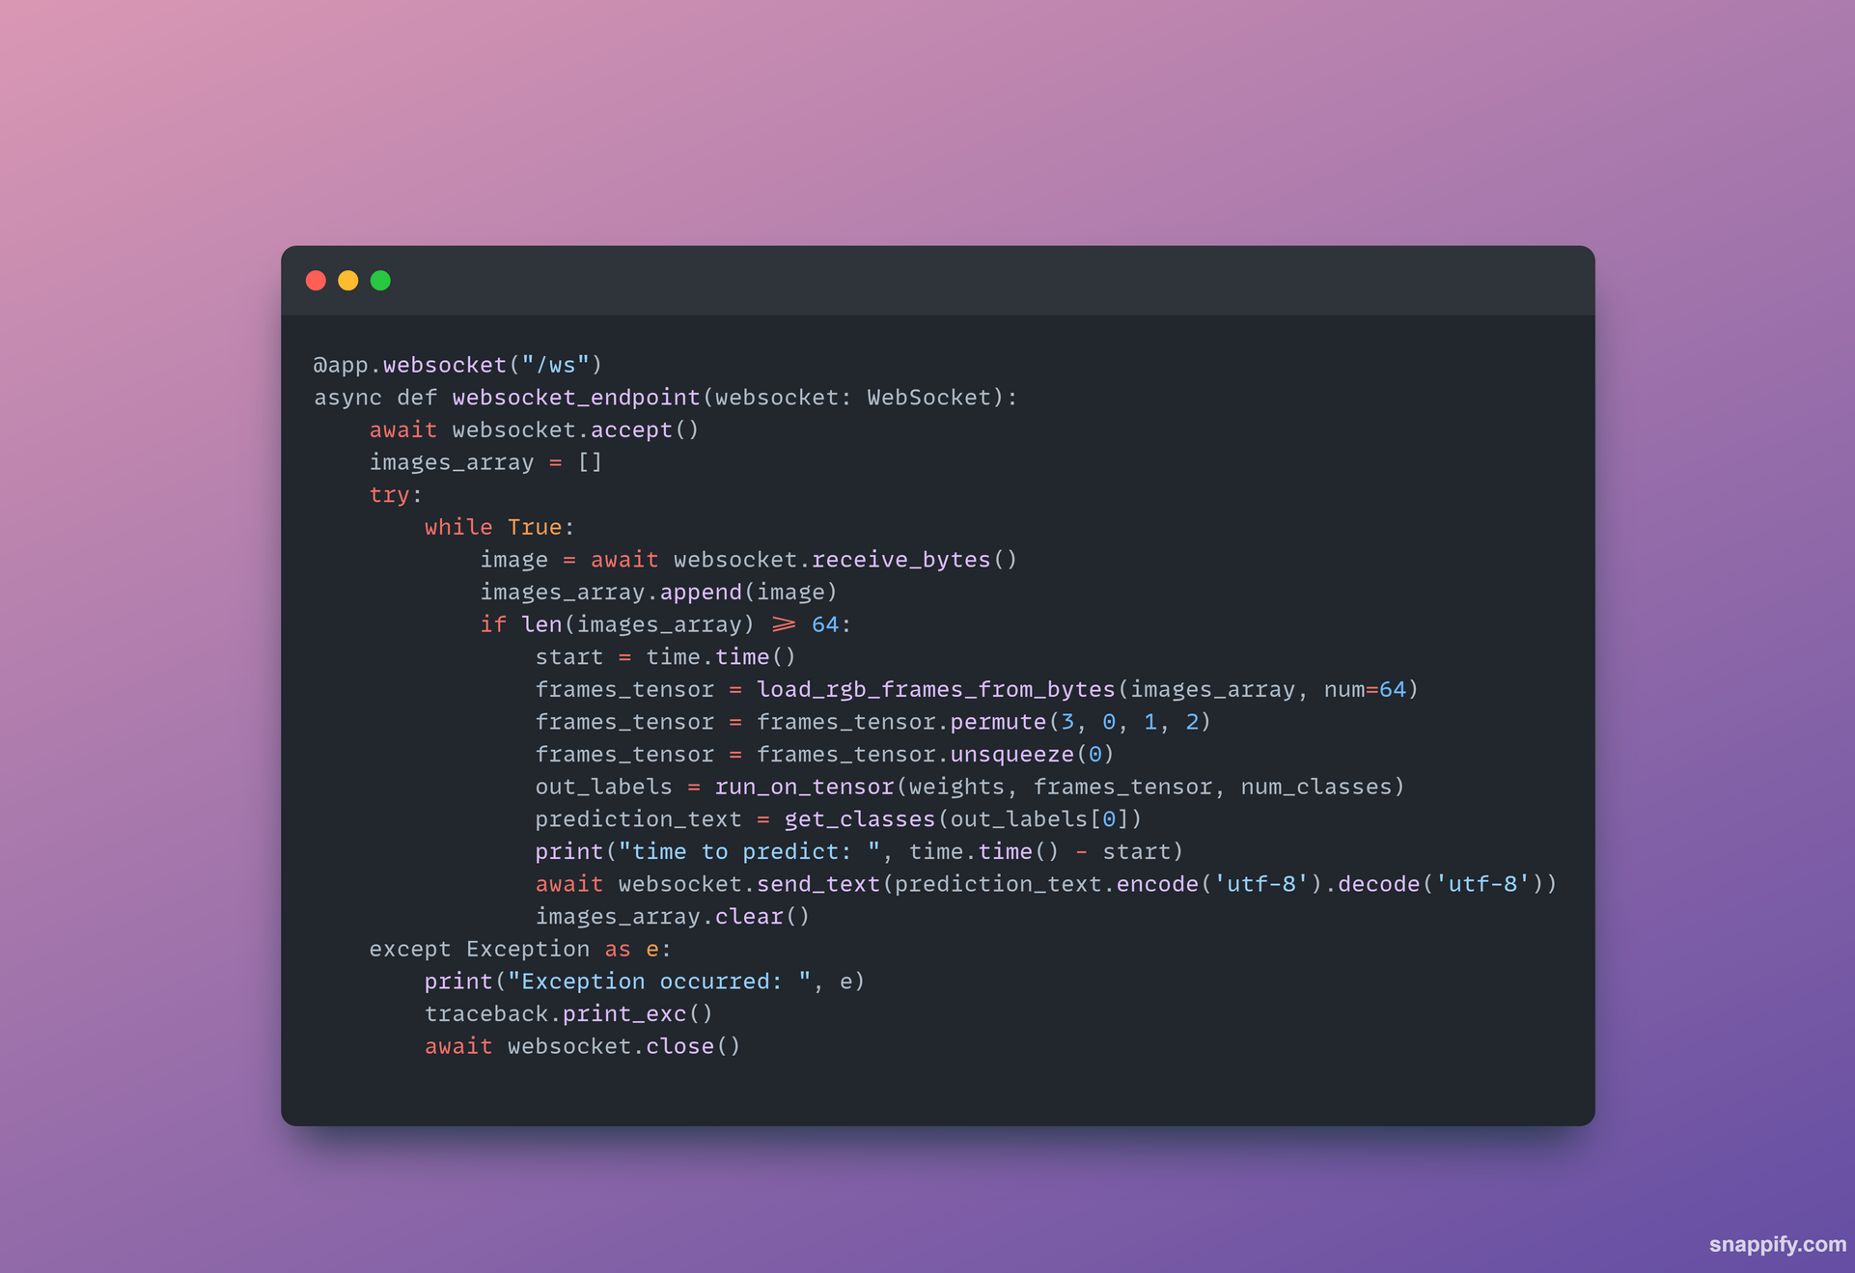
WebSocket Endpoint
SignSpeaks
Add Company Name

Slide 33
8.
Frontend
SignSpeaks

Slide 34
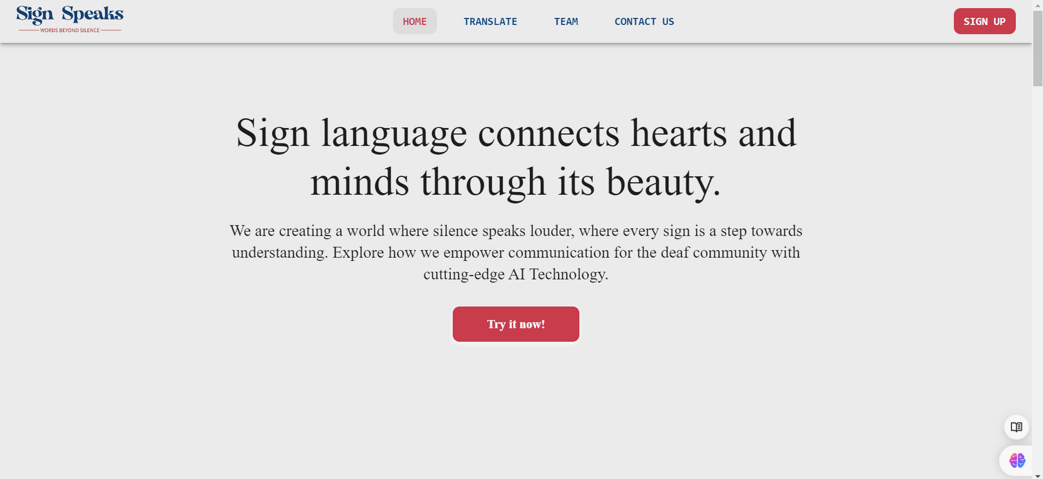
SignSpeaks
Add Company Name

Slide 35
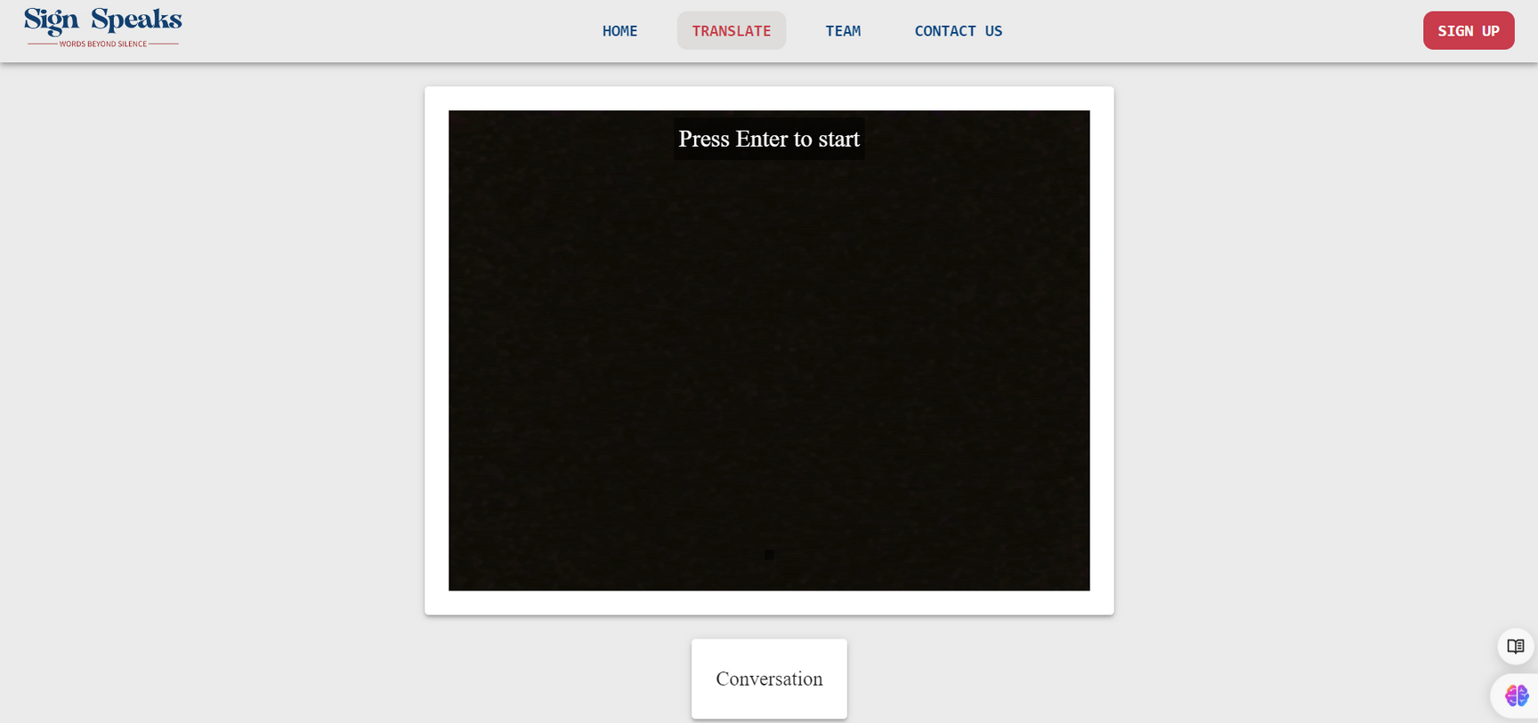
SignSpeaks
Add Company Name

Slide 36
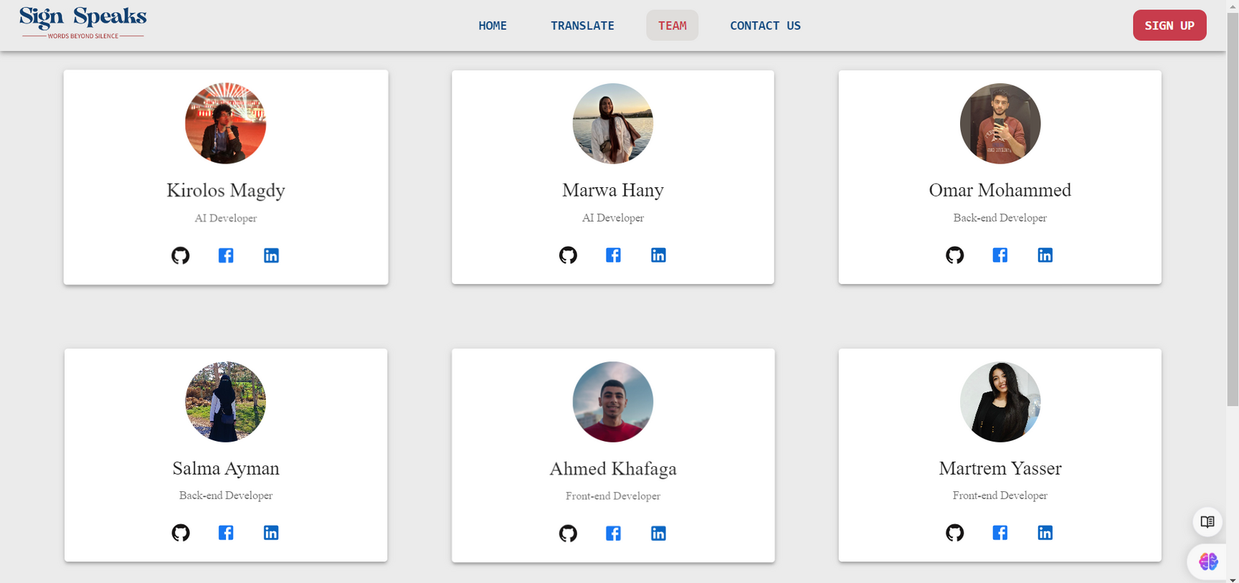
SignSpeaks
Add Company Name

Slide 37
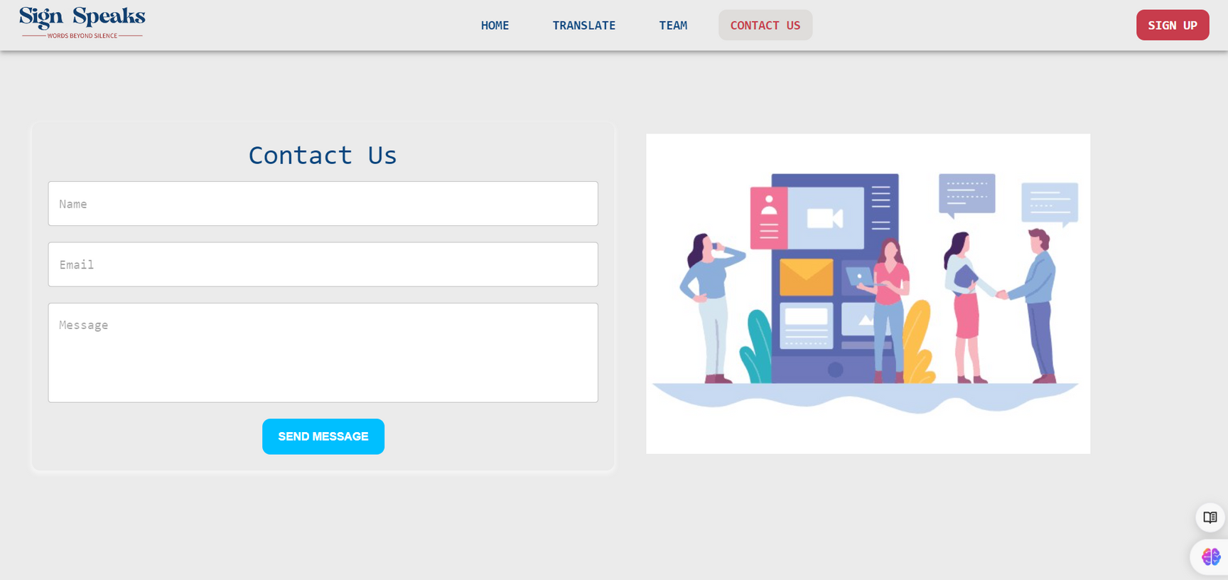
SignSpeaks
Add Company Name

Slide 38
Thank You
SignSpeaks
Add Company Name

